Slide 1
Rising ninth grade advisement Infinite Campus Course Scheduling

Slide 2
Objectives
GAFUTURES
Purpose
How to create a GAFUTURES account
HOPE GPA
HOPE Rigor course requirements
DeKalb County School District High School Promotion Policy
DeKalb County School District Graduation Requirements
Summer School Options
DUAL Enrollment in Georgia
Elective Course Selection in Infinite Campus

Slide 3
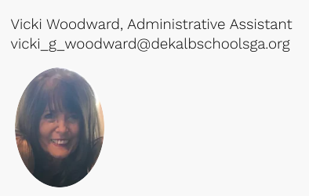
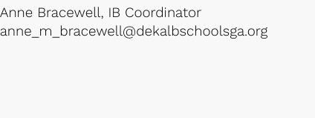
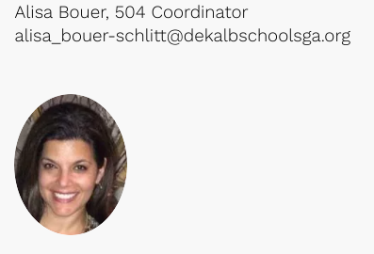
DHHS Counseling Department

Slide 4
Gafutures.org
GAfutures.org is Georgia’s primary resource to help students plan, apply, and find affordable ways to pay for their post-secondary education.
Features:
Track HOPE GPA
Send transcripts
Apply to colleges
Click here to view a video tutorial on how to set up your GAFutures account

Slide 5
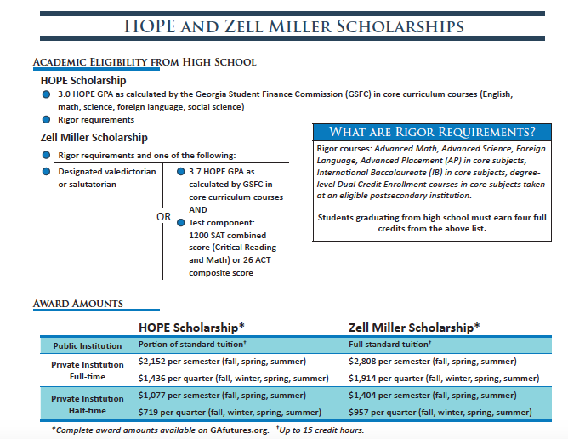
HOPE GPA & Scholarship requirements
Georgia's HOPE Scholarship is available to Georgia residents who have demonstrated academic achievement. The scholarship provides money to assist students with the educational costs of attending a HOPE eligible postsecondary institution located in Georgia.

Slide 6
ACADEMIC HOPE Rigor
For the High School Graduating Class of 2017 and beyond, a student meeting the requirements to be a HOPE Scholar at the time of high school graduation must earn a minimum of four full credits from the academic rigor course categories listed below prior to graduating from high school.
Link to HOPE Rigor Course List

Slide 7
Dekalb county school district PROMOTION POLICY
Students are required to complete 24 units in order to meet the requirements for graduation.
The requirements for promotion are as follows::
9th to 10th |  | 10th to 11th |  | 11th to 12th
6 Credits |  | 12 Credits |  | 18 Credits
3 Core Credits | 3 Elective Credits | 6 Core Credits | 6 Elective Credits | 9 Core Credits | 9 Elective Credits
Core courses include English, mathematics, science, social studies, and world language
Link To: GADOE Graduation Rule SBOE Rules/160-4-2-.48.pdf

Slide 8
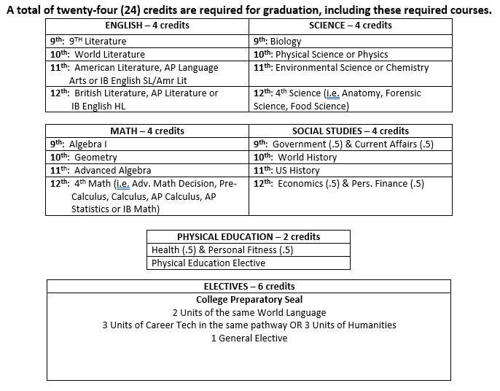
DEKALB COUNTY SCHOOL DISTRICT GRADUATION REQUIREMENTS

Slide 9
High School Courses Taken in Middle School
Unit credit may be awarded for courses offered in the middle school grades that meet the following criteria:
The course must meet all 9 through 12 state curriculum standards.
The transcript record for the course must include a Milestones End-of-Course (EOC) score if an EOC is required by the Georgia Department of Education.
Grades must incorporate EOC scores
The unit(s) earned in middle school shall be posted on the high school transcript, the grades for these courses will be used to calculate grade-point averages for purposes of class rank.
The the grades for these courses will NOT be used to calculate grade-point averages for purposes of HOPE scholarship eligibility.

Slide 10
Summer school
What Platform does DCSD use for summer courses?
Georgia Virtual School or DCSD FLEX Academy
What courses can my student take during the summer?
9th grade Health and 9th grade PE
Who should approve my student’s course?
Registration and approval must be made with the student’s middle school Counselor NOT THE HIGH SCHOOL. The student is considered an 8th grade students until July1st.
DCSD GPA Impact
The courses will be calculated in the DCSD GPA calculation.
HOPE GPA Impact
The course WILL NOT COUNT TOWARDS THE HOPE CALCULATION BECAUSE THE courses ARE ELECTIVE COURSES.

Slide 11
Dual enrollment
Students may enroll on a part-time or full-time basis as a Dual Enrollment student and take college courses at their high school or on a postsecondary campus. Students will receive high school and college credit simultaneously when attending and passing approved college classes.
DUAL Enrollment Video
GRADE LEVEL ELIGIBILITY
9th Grade | 10th Grade |  | 11th & 12th
Students in the 9th grade are not eligible to participate in the Dual Enrollment funding Program. | CTAE COURSES ONLY 10TH grade students may enroll in approved Career, Technical and Agricultural Education (CTAE) courses listed on the Course Directory at a participating TCSG institution only. | Students may take any approved Dual Enrollment courses listed on the Course Directory, at an eligible participating postsecondary institution (USG, TCSG or private). Eligibility: SAT score of 1200 or ACT composite score of 26 in a single national test. | Students may take any approved Dual Enrollment courses listed on the Course Directory, at an eligible participating postsecondary institution (USG, TCSG or private).

Slide 12
SCHEDULING AT DHHS
DHHS is on a block schedule
Students have 4 classes each semester
Classes are 90 minutes
Most classes are a semester long
Students can earn 1 Credit Unit each “Block” per semester

Slide 13
Elective Pathways
CTAE Pathways – 3 classes to complete the pathway
Intro to Graphics and Design
Graphic Design and Production
Advanced Graphic Design
Intro to Business
Legal Env. of Business
Entrepreneurship
Food, Nutrition, Wellness
Food for Life
Food Science
Cross Keys Pathway Options (11th & 12th Grade)
Humanities Pathway-
Art Classes
Music Classes
Drama
Newspaper
Yearbook
World Language (III, IV, V)
ESOL
Dual Enrollment Electives
AP Electives
IB Electives
Interior Design
Fashion Design
Textile Science
Found. of Engineering
Engineering Concepts
Engineering Applications
ROTC I, II, III

Slide 14
There are Different variations
9th Grade Sample Schedule
9th Grade IB Prep Sample Schedule
1st Semester | 2nd Semester
9th Grade Literature | Personal Fitness/Health
Math | American Government/Current Issues
Spanish/French | Environmental Science
Elective | Elective
1st Semester | 2nd Semester
9th Grade Literature | Personal Fitness/Health
Math | Accelerated Biology
AP Government A | AP Government B
Spanish/French | Elective

Slide 15
9th Grade Electives
CTAE (“Other” Section)
Intro to Business (07.4413000)
Food, Nutrition, & Wellness (20.4161000)
Foundations of Engineering (21.4250000)
Intro to Graphic Arts and Design (48.5610000)
Interior Design (20.4410000)
Humanities
Visual Arts (50.0211000)
Drama (52.0210000)
Orchestra (53.0561000)
Band (53.0361000)
Chorus (52.0211000)
PE/Health
Naval ROTC (28.0220000)
PE (36.0110000)

Slide 16
Entering Course Requests ALL course requests must be completed through your Infinite Campus student account. Course selections must be done on a laptop or desktop computer, a cell phone will not work.

Slide 17
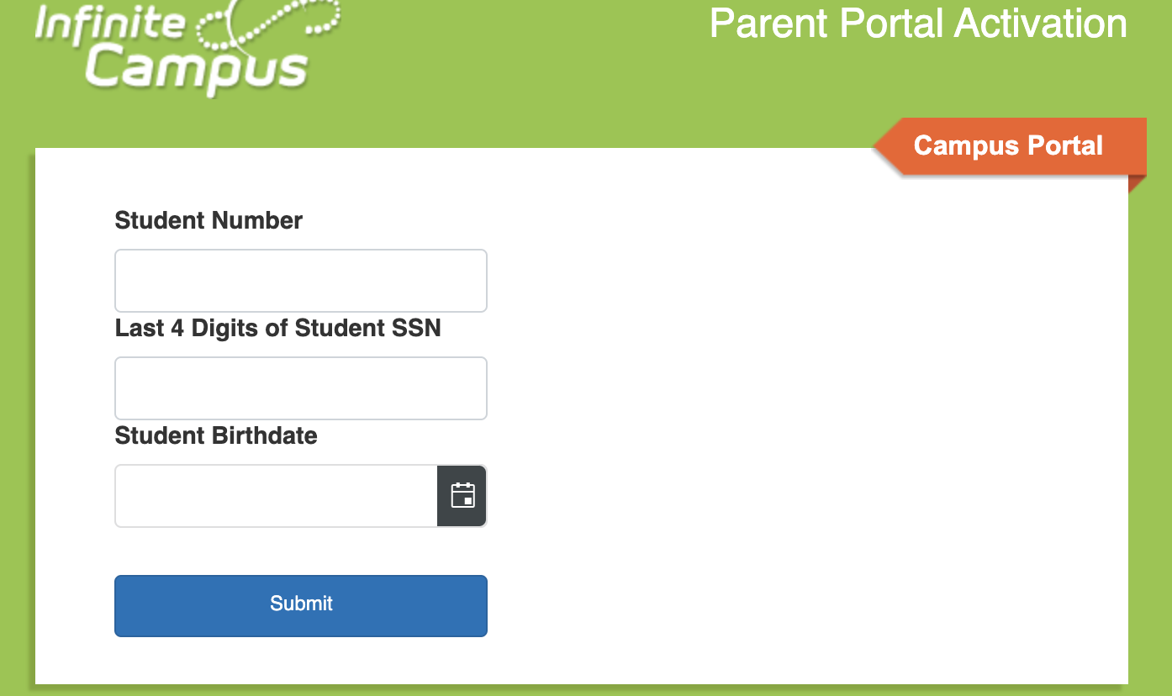
Need an infinite campus portal account?
If you do not have a portal account or if you do not remember your user name, go to the DCSD Portal Account Activation to get your new account activation code. You can use the same link to look up your user name.
DCSD Portal Account Activation Link:
https://campus.dekalb.k12.ga.us/campus//K12_Custom/cParent/index.jsp?appName=dekalb

Slide 18
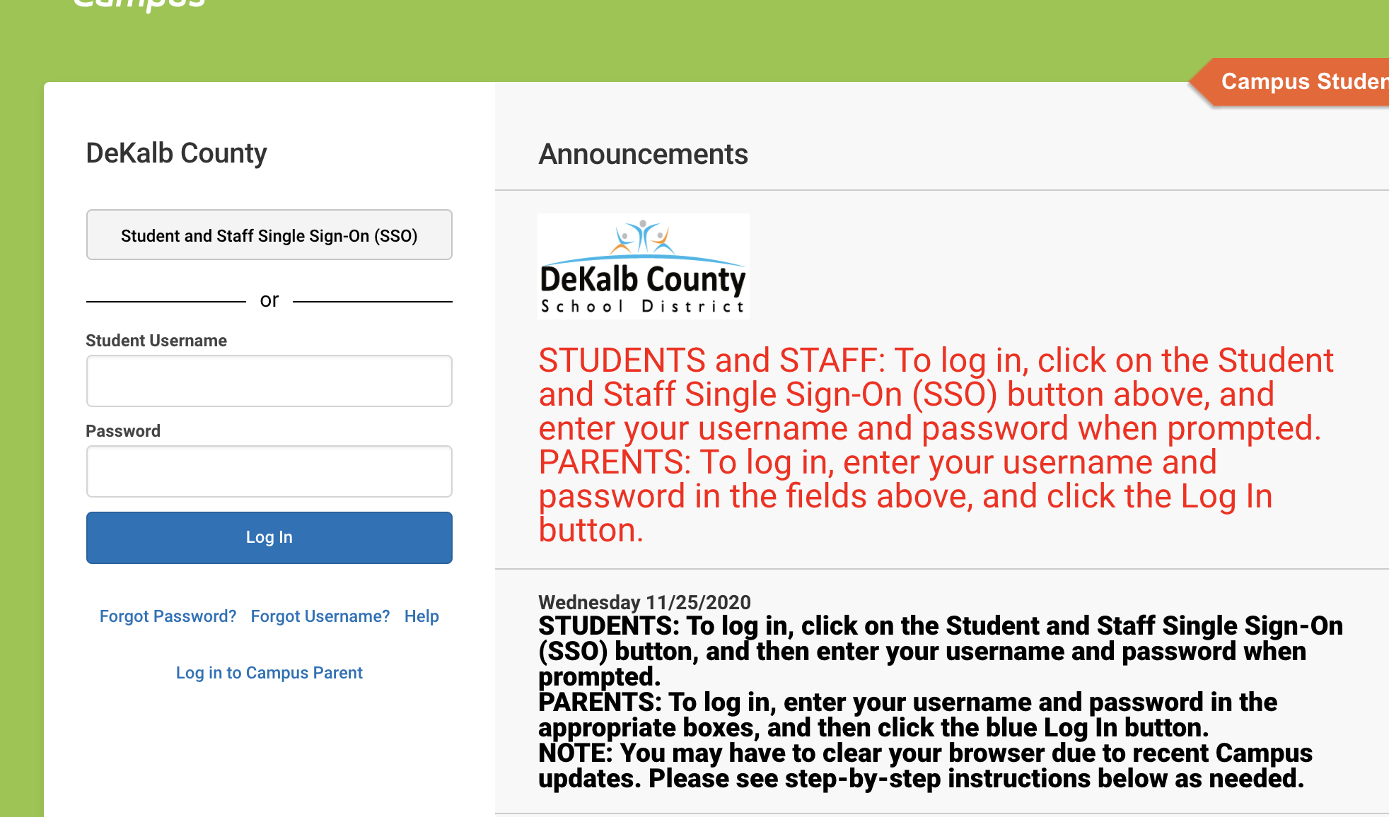
Login into Your student infinite campus account
Students
Parents
https://campus.dekalb.k12.ga.us/campus/dekalb.jsp

Slide 19
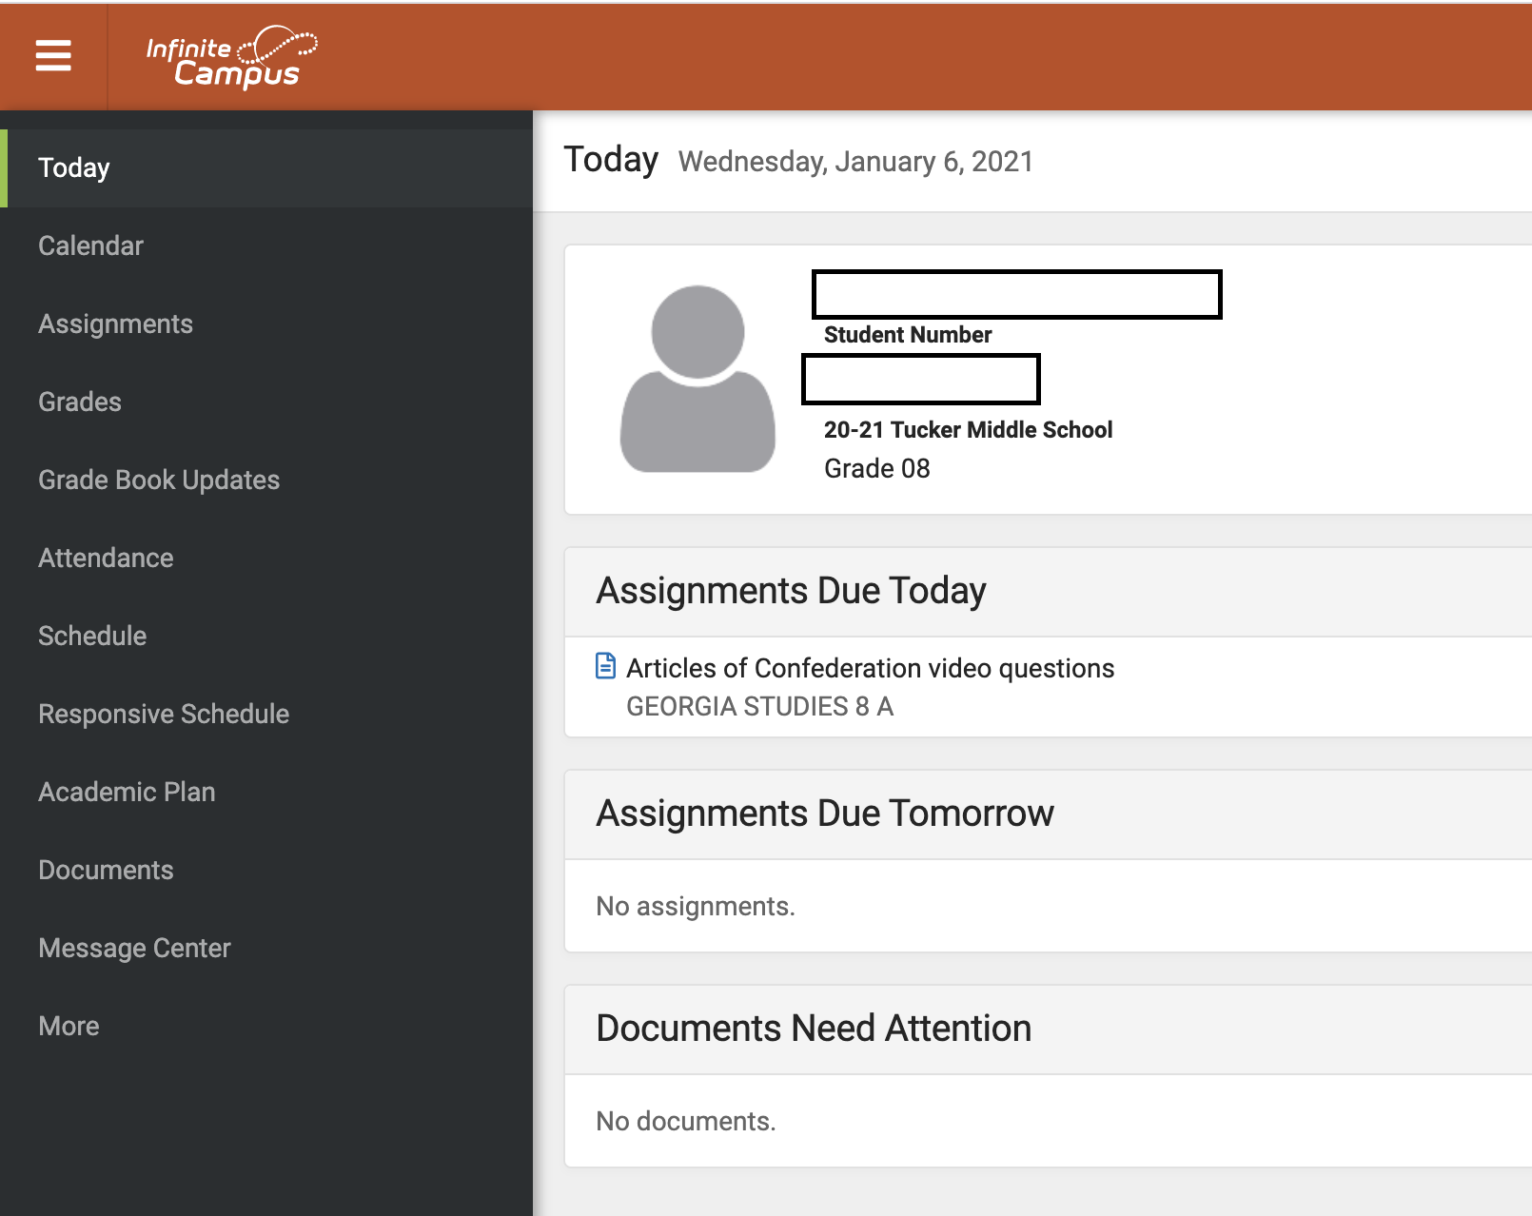
Student view after infinite campus login After logging into Campus select academic plan from the Index.

Slide 20
Diploma Type
ALL 8TH GRADE STUDENT’S DIPLOMA TYPE IS PRESELECTED FOR THE COLLEGE PREP WITH HUMANITIES.
ALL 8TH GRADE STUDENT’S AND PARENTS’ MAY CHANGE THE DIPLOMA TYPE HERE.

Slide 21
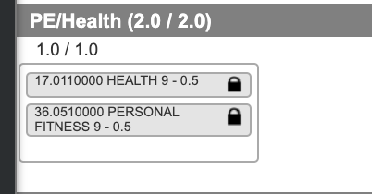
Core
&
Health/PE courses have been preselected for all 8th grade students.

Slide 22
The Course Plan tool contains a checkbox that indicates the parent/guardian approved the student’s plan based on the parent’s selection of the Approved by parent/legal guardian checkbox on the Portal Academic Planner screen.
When students build their course plan in the Portal, parents/guardians should be reviewing it. This ensures the student is taking the correct courses in the correct time frame with the adequate number of credits in a certain term, with a desired amount of rigor and challenge.

Slide 23
8th grade students should select elective courses, foreign language & alternate elective courses

Slide 24
Save course selections

Slide 25
QUESTIONS???
https://forms.office.com/r/UMZiU9Jvex

Slide 26
RESOURCES CORE COURSE OFFERINGS & Sequencing

Slide 27
English hope/core Courses
 | DCSD Requirements | ADVANCED PLACEMENT | DUAL ENROLLMENT
GRADE 9 | LIT 9 23.06100
GRADE 10 | WORLD LIT 23.06300 |  | ENG1101
GRADE 11 | AMERICAN LIT 23.05100 | AP Lang 23.05300 | ENG 2130
GRADE 12 | BRITISH LIT 23.05200 | AP Literature | ENG 1102

Slide 28
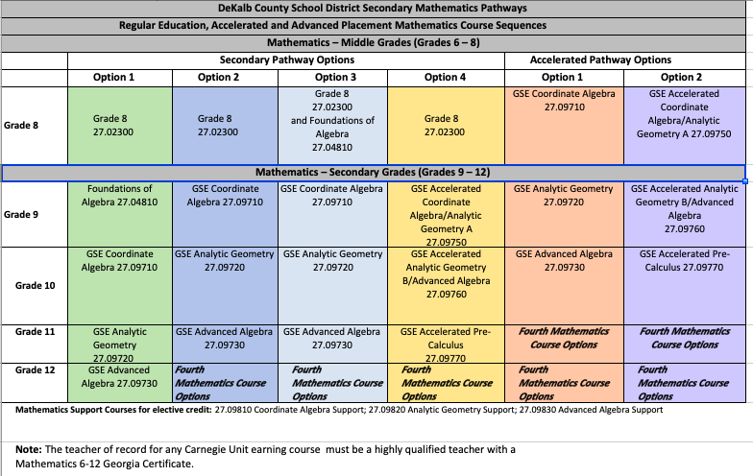
Mathematics HOPE/core courses

Slide 29
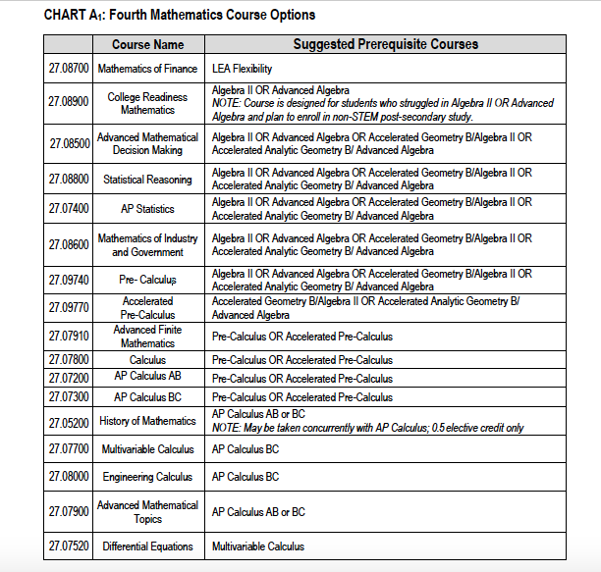
Fourth year Mathematics options HOPE/core courses

Slide 30
Science hope/core courses
 |  | ADVANCED PLACEMENT | DUAL ENROLLMENT
GRADE 9 | Biology |  | Bio1111 with Bio1111 Lab
GRADE 10 | Physical Science Physics |  | PHYS 1111 with PHYS 1111 Lab
GRADE 11 | Chemistry Earth Systems Environmental Science | Any AP science course | CHEM1211 with CHEM1211 Lab
GRADE 12 | General Horticulture Anatomy Environmental Science any 4th science | AP Computer Science Any AP Science | Any Dual Enrollment Science course

Slide 31
Social Studies Hope/core courses
 | DCSD Requirement | ADVANCED PLACEMENT | DUAL ENROLLMENT
GRADE 9 | American Government | AP American Government | POLS 1101
GRADE 9 | World Geography | AP Human Geography
GRADE 10 | World History | AP World History | HIST 1111
GRADE 11 | US History | AP US History | HIST 2111 HIST 2112
GRADE 12 | Economics | AP Macro- Economics AP Micro-Economics | ECON 1101

Slide 32
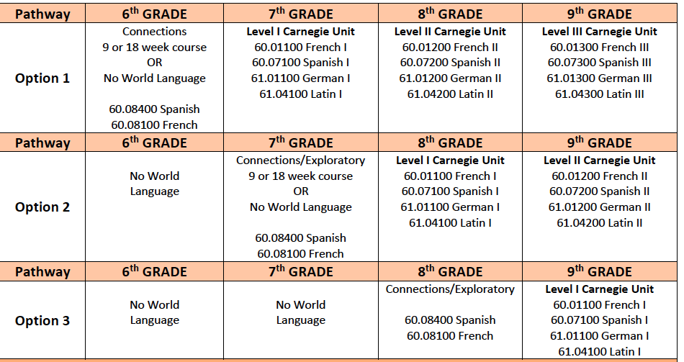
World Language hope/core course
* 2 Units of same modern language or Latin are required for 4-year college admission

Slide 33
RESOURCES CTAE ELECTIVE COURSE OFFERINGS

Slide 34
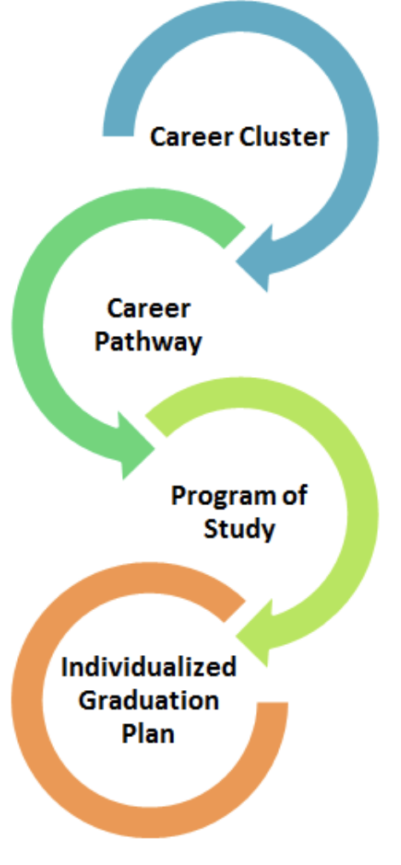
1. Agriculture, Food and Natural Resources 2. Architecture and Construction 3. Arts, AV/Technology and Communications 4. Business Management and Administration 5. Education and Training 6. Energy 7. Finance 8. Government and Public Administration 9. Health Science 10. Hospitality and Tourism Health Science 11. Human Services 12. Information Technology 13. Law, Public Safety, Corrections and Security 14. Manufacturing 15. Marketing 16. Science, Technology, Engineering, Mathematics (STEM) 17. Transportation, Distribution and Logistics
Career Clusters/Pathways
Georgia’s Career Clusters allow students to choose an area of interest in high school from the 17 clusters listed below. Students take classes tailored to their cluster, which helps them navigate their way to greater success – no matter what they choose to do after high school graduation. Each cluster will include multiple career pathways.

Slide 35
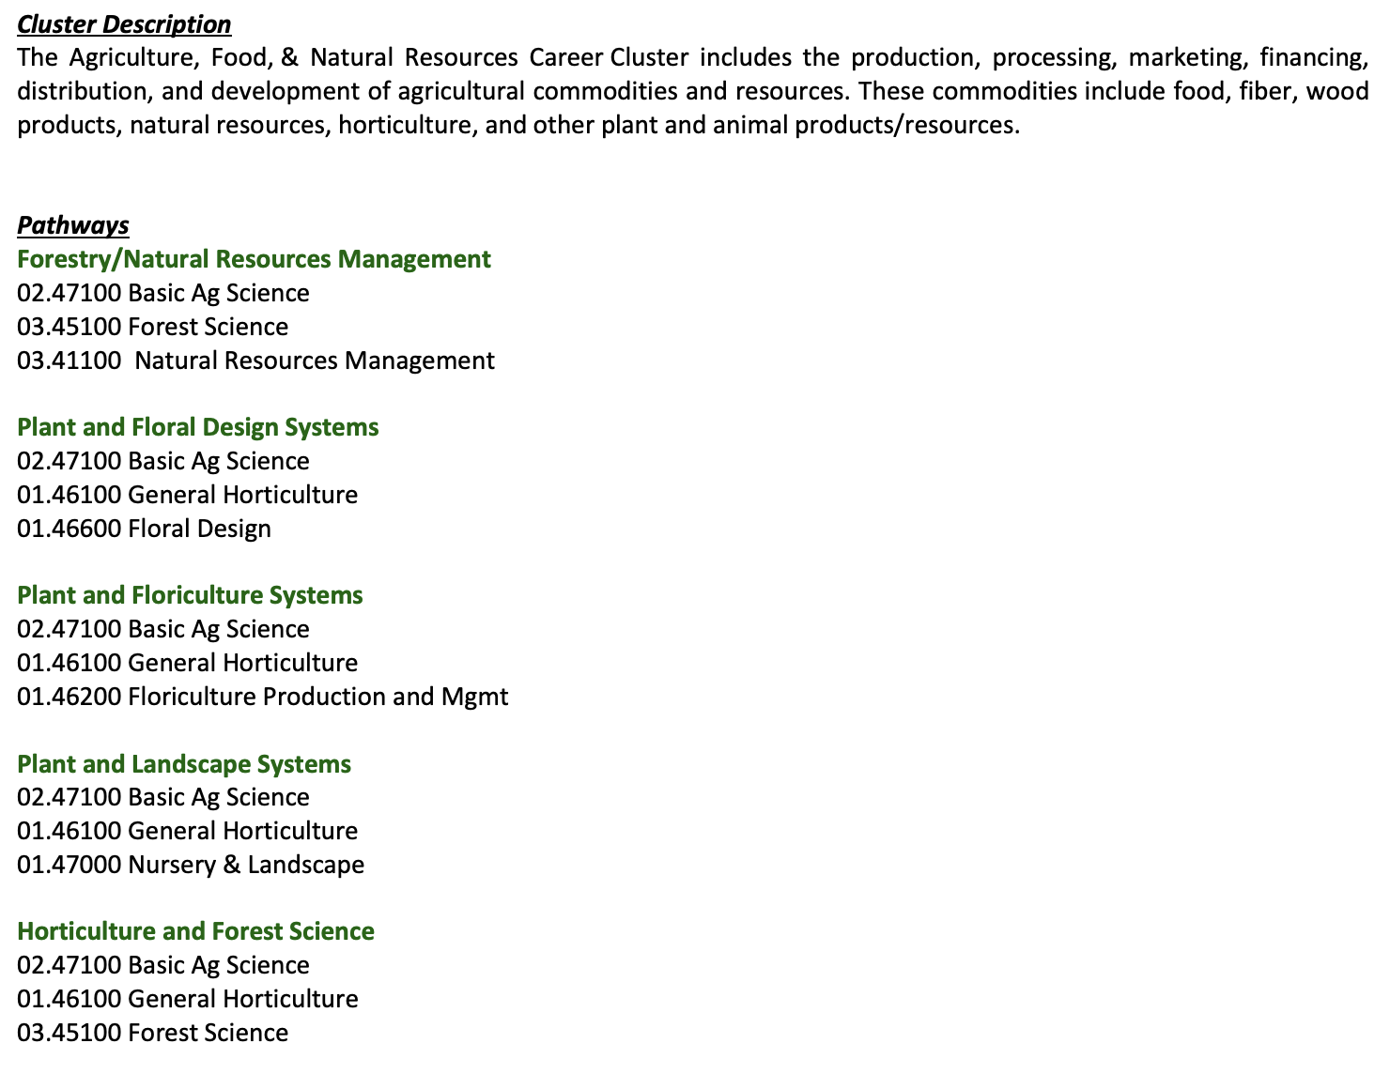

Slide 36
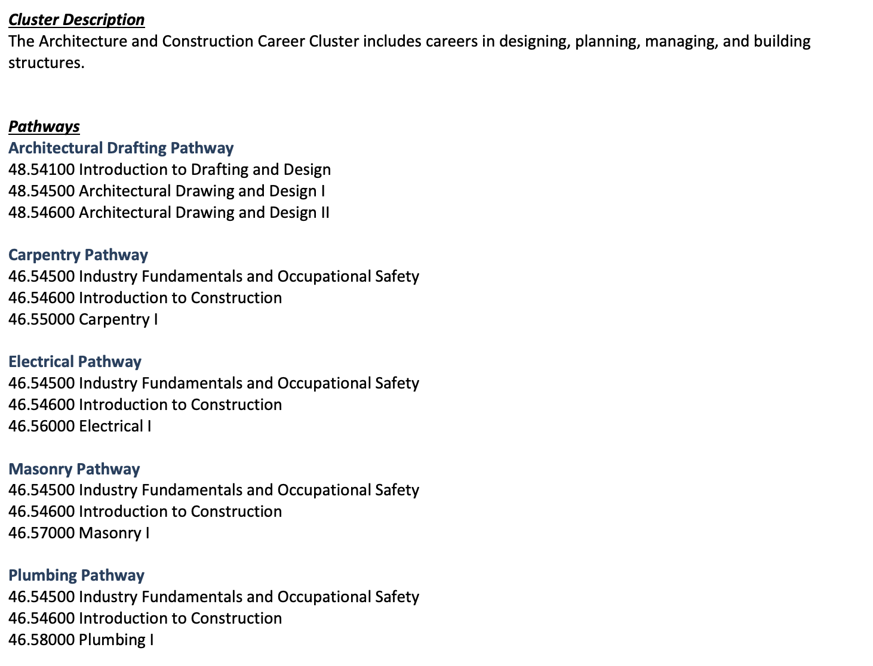

Slide 42
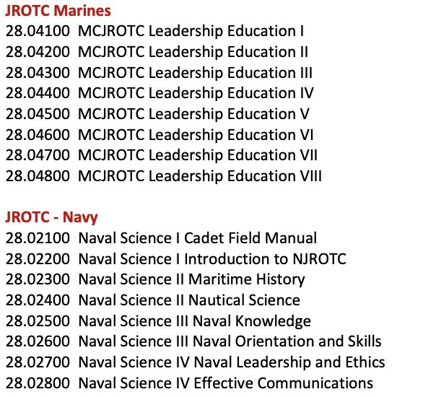

Slide 45
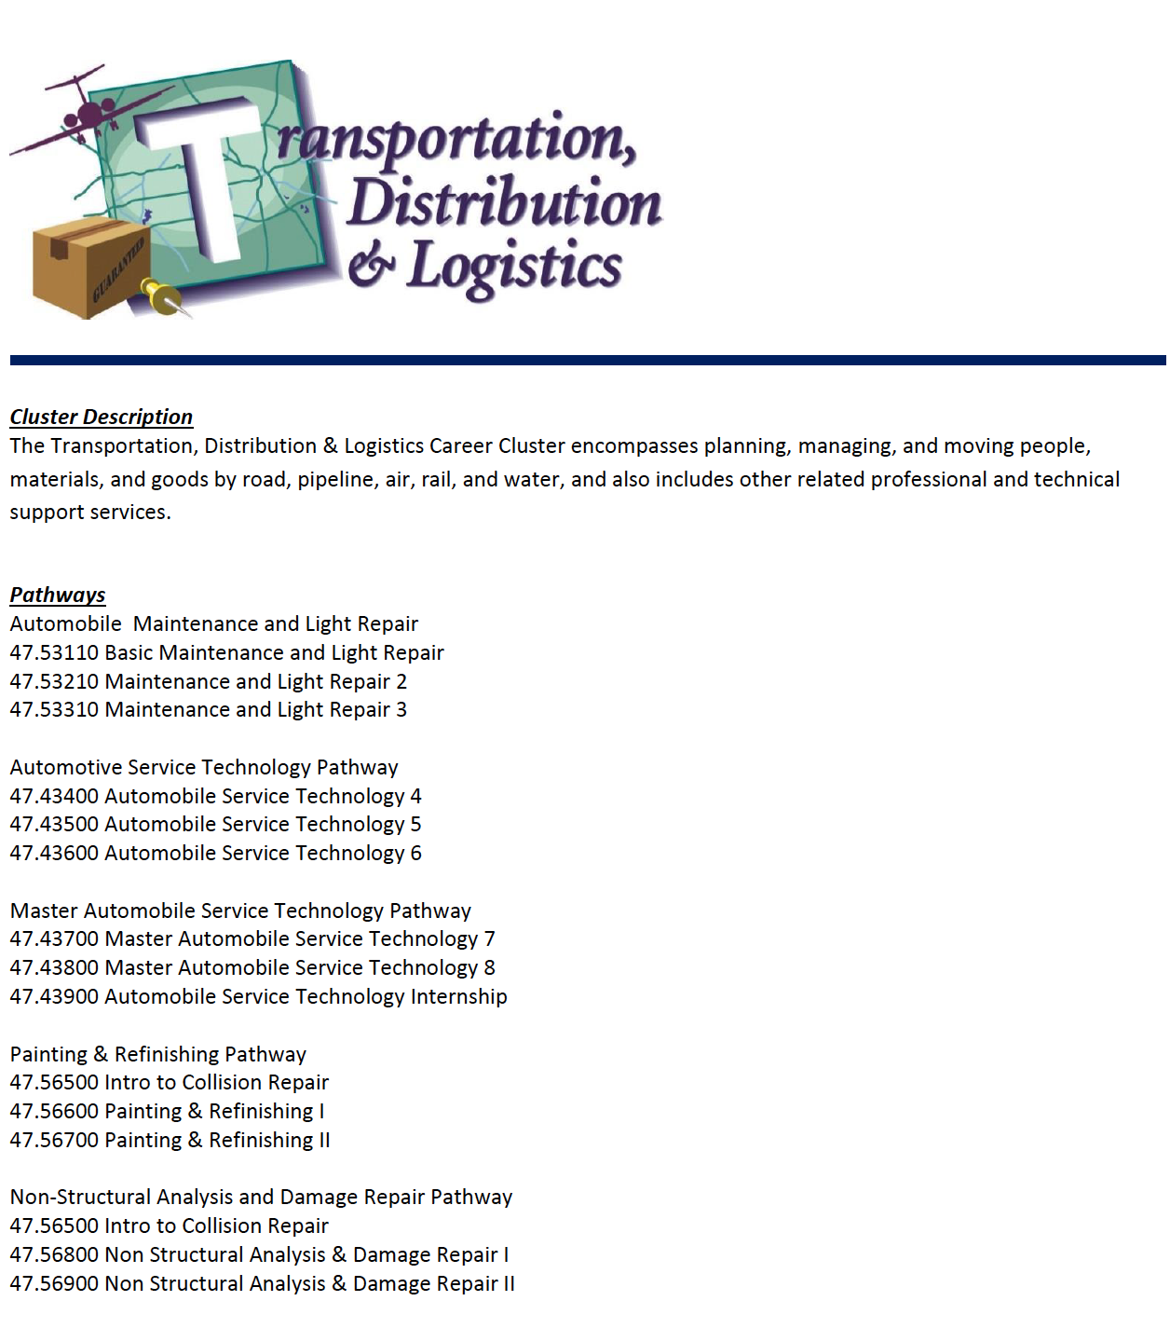

Slide 52
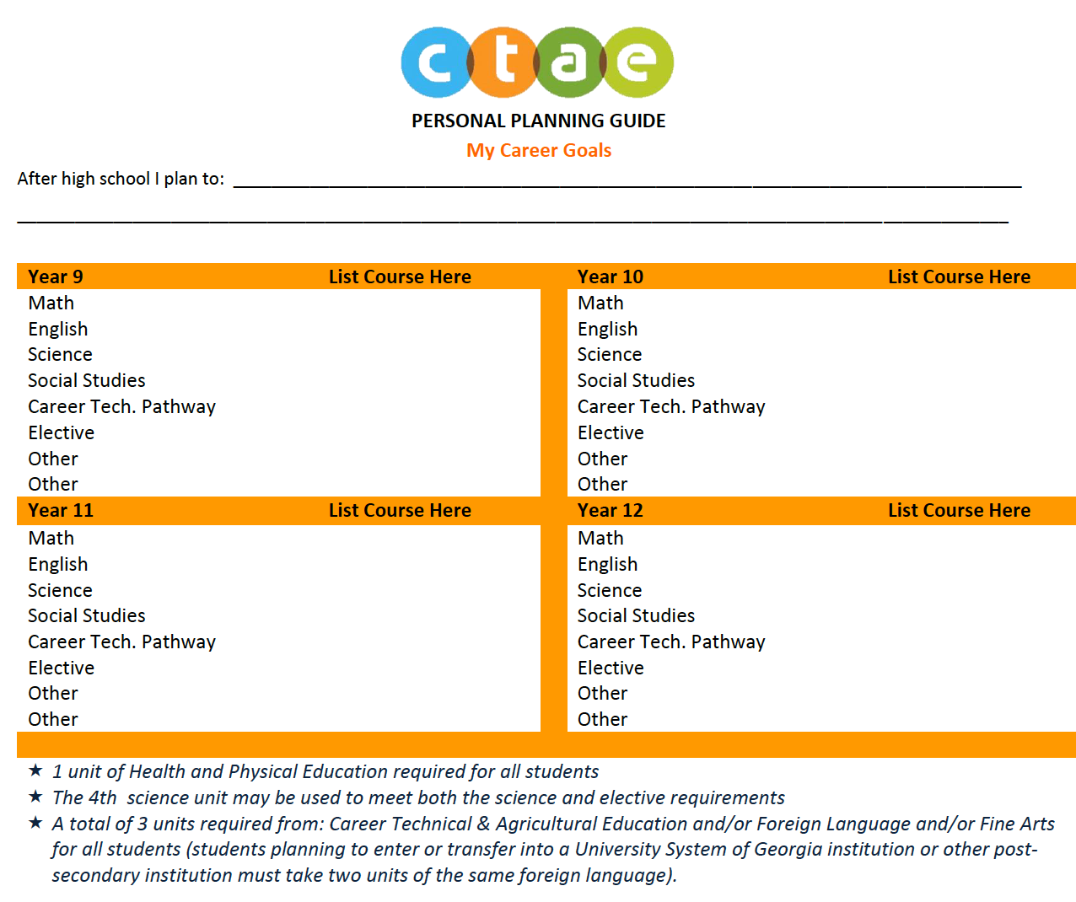

Slide 53
Links
https://dcsd-my.sharepoint.com/:b:/g/personal/e19996810_dekalbschoolsga_org/EboICqZO2cJEpyf4e8LLO-sBlTXFgchb9HE7VuY-abKjeQ?e=bY4UEE
GaFutures account set up tutorial: https://www.youtube.com/watch?v=kgAGtSSvxSI
Listing of Courses Possessing Academic Rigor to Meet the HOPE Rigor Requirement (September 2020): https://dcsd-my.sharepoint.com/:b:/g/personal/e19996810_dekalbschoolsga_org/EboICqZO2cJEpyf4e8LLO-sBlTXFgchb9HE7VuY-abKjeQ?e=bgxNVM
HOPE Scholarship Eligible Institutions: https://dcsd-my.sharepoint.com/:b:/g/personal/e19996810_dekalbschoolsga_org/EasnVKO_-HZIhnToD6k90BwB7Xl9EzHGIBYrv7GzDCaBRQ?e=vQjQNn

